Slide 1
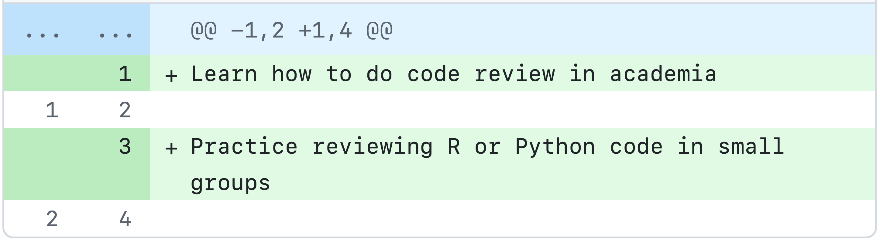


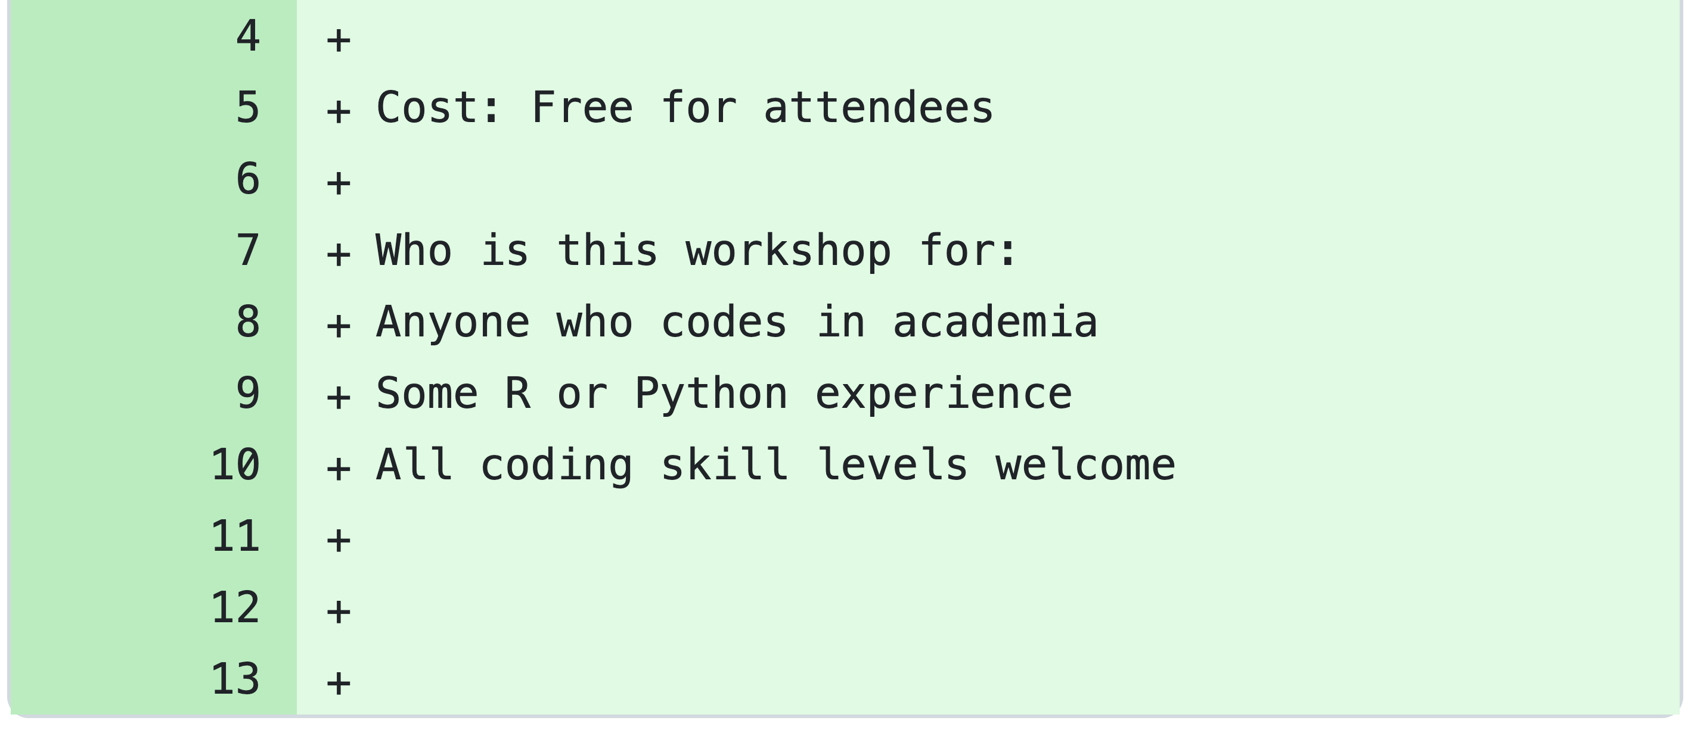
Code Review in Academia Workshop
10am
-
11am
+ Introductory presentation
(attendee laptops not required)
Thursday
13th March 2025
11.00
-
11:30
+ Tea/coffee break
(please do not bring food/drink into this room G.03)
Room G.03
Bayes Centre
The University of Edinburgh,
EH8 9BT
11:30
-
12:30
+ Practice reviewing R or Python in small groups/pairs
(attendee laptops required)

Slide 2





Who we are
Amelia Edmondson-Stait
(post-doc)
Emily Ball
(post-doc)
Hannah Casey
(PhD student)
Ella Davyson
(PhD student)
Poppy Grimes
(PhD student)
Psychiatry Department, in Prof Andrew McIntosh & Prof Heather Whalley’s groups
Apply epidemiological and statistical methods to large population cohorts and electronic health records.
Advocators of good coding practices in academia.
This workshop aims to initiate discussion and teach some concepts of code review.
Funding for this workshop comes from the Improving Research Community Builder Award

Slide 3
Workshop Expectations
Participation is encouraged
This is a safe, supportive, respectful space
It’s ok to make mistakes
We’ll use a “Parking Sheet” for items that are off topic or taking up too much time

Slide 4
Code Review in Academia Workshop
Introductory presentation:
What is code review
How to do a code review
Tools for reviewing
Role of author & reviewer
Code review checklist

Slide 5



Coding practices in industry

Slide 6



Coding practices in industry
Testing
Why code review is important in industry
Mistakes happen
↑ code quality
Opportunity to learn
Discover bugs earlier
↑ maintainability of code

Slide 7


Coding practices in academia

Slide 8
Coding practices in academia
Why code review is important in academia
Mistakes happen
↑ code quality → reproducibilty
↑ research quality
Opportunity to learn
Discover bugs earlier
↑ maintainability → reproducibilty

Slide 9




Apply industry methods to academia

Slide 10

Apply industry methods to academia

Slide 11
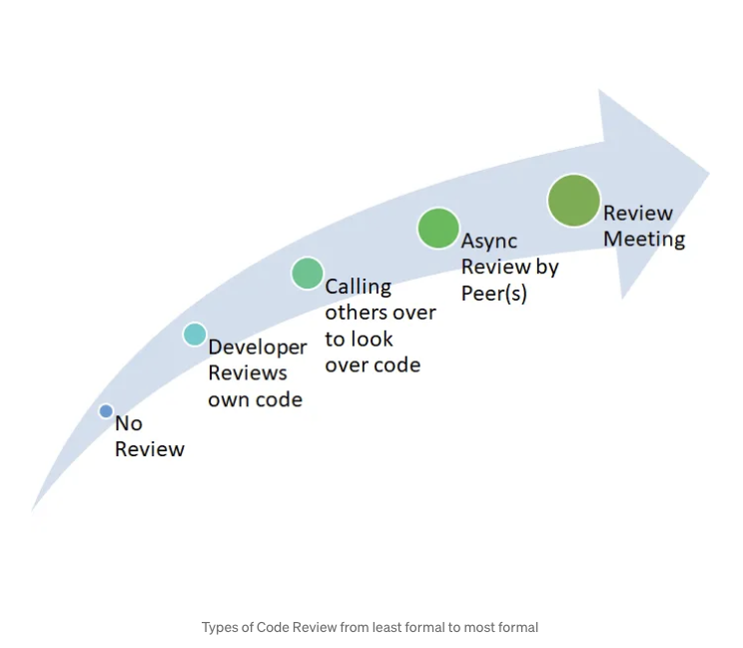




Types of code review
Group review meeting
Over-the-shoulder
No review
Peer review / asynchronous

Slide 12
Types of code review
Group review meeting
Over-the-shoulder
No review
Peer review / asynchronous

Slide 13
Summary so far...
Coding in industry vs academia is different
Code review is probably also going to be different
Next...
Methods used for asynchronous code review

Slide 14
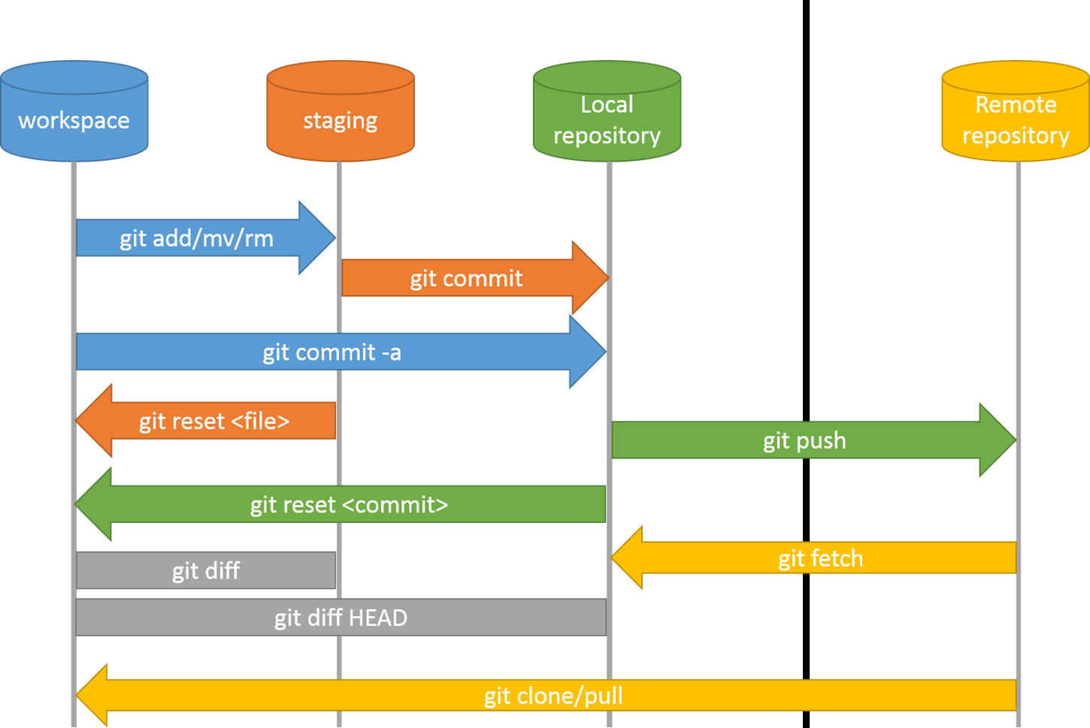
Industry uses “pull requests” for peer review
Image from: https://r-cubed-intro.rostools.org/sessions/version-control
Notes:
Hands up for:
How many people use/heard of git?
How many people have used git branches?
How many people have used/understand pull requests?

Slide 15
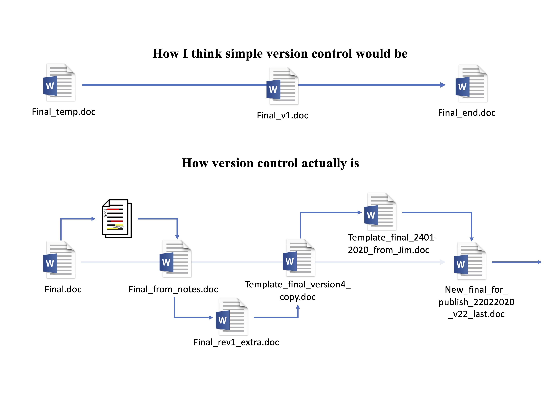
What is git... git branches... pull requests?
Image from: https://r-cubed-intro.rostools.org/sessions/version-control

Slide 16
What is git... git branches... pull requests?
git = version control system
Image from: https://r-cubed-intro.rostools.org/sessions/version-control

Slide 17
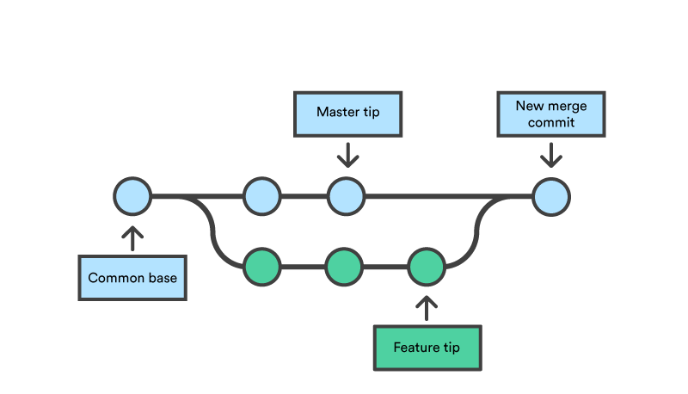
What is git... git branches... pull requests?
git = version control system
’main’ branch
= git commit
(change in file)
Image from: https://r-cubed-intro.rostools.org/sessions/version-control

Slide 18
What is git... git branches... pull requests?
git = version control system
’main’ branch
’feature’ branch
= git commit
(change in file)
Image from: https://r-cubed-intro.rostools.org/sessions/version-control

Slide 19
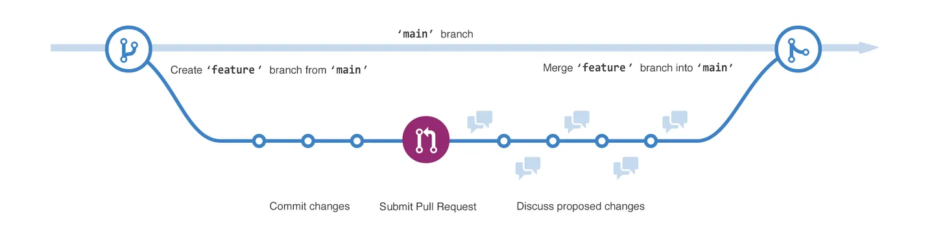
What is git... git branches... pull requests?
’main’ branch
Create ’feature’ branch from ‘main’
Merge ’feature’ branch into ‘main’
Commit changes
Submit Pull Request
Code reviewed/ commit changes
Pull requests are useful for reviewing changes made to an existing code base

Slide 20
Industry uses “pull requests” for peer review
’main’ branch
Create ’feature’ branch from ‘main’
Merge ’feature’ branch into ‘main’
Commit changes
Submit Pull Request
Code reviewed/ commit changes
Pull requests are useful for reviewing changes made to an existing code base

Slide 21
“Pull requests” for peer review in academia?
Industry:
Changes made to an existing code base
Changes to code are reviewed
Academia:
Each researcher/project = new code base
Not just changes that need reviewing

Slide 22
Do we need something less advanced and more suitable for academia?

Slide 23
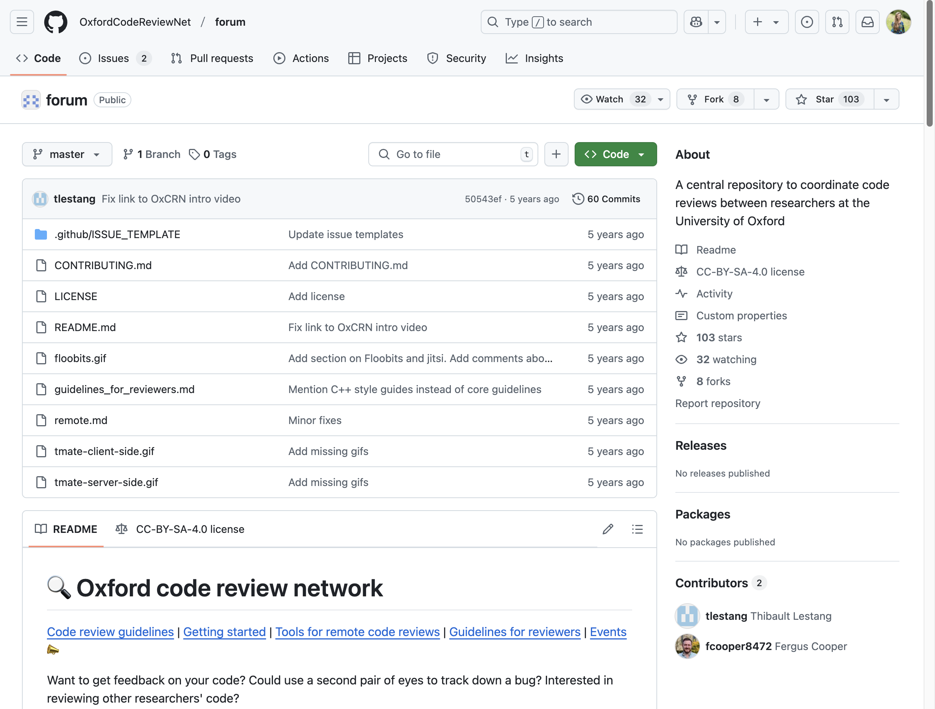
Oxford Code Review Network
https://github.com/OxfordCodeReviewNet/forum

Slide 24







Barriers for code review

Slide 25
Barriers for code review
Reviewing the code is more important than the tools used to review

Slide 26
Personal experience of code review
Didn’t use pull requests or GitHub issues...
My code was on a shared GitHub repository
New coding language to me - nextflow
My colleague looked at the script I was working on
We had regular meetings where I would walkthrough/explain the code
Restructured logic of code execution, learnt new functions, etc.

Slide 27
Summary so far...
Tools for code review balanced with reducing barriers
Next...
Explain how a code review is done (role of author & reviewer)
Things to look for in code when reviewing (checklist)

Slide 28

Overview - How to do a code review
Role of code author
Role of code reviewer
Prepare code
Initial meeting?
Send code to reviewer
Review code
Walk-through code
Agree on expectations & objectives
Find reviewer
Provide feedback
Improvements & follow up

Slide 29
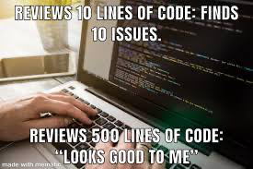



Preparing code for review
Role of code author
Identify 50 to 200 lines of code you want reviewed
Make it easy to review: include comments and documentation
Decide the focus of the review in advance
Ask for specific feedback if needed
Be prepared to walk through your code in the logical order of execution
</>
README.md
# -----------
# -----------
# -----------
# -----------
</>
</>
</>

Slide 30
Finding a reviewer
Role of code author
Any researcher that codes is a good candidate
Any coding experience is useful
Colleagues in your research group,
collaborators,
mentors,
students...

Slide 31
How to do a code review
Role of code reviewer

Slide 32

How to do a code review
Role of code reviewer
Simply ask questions
Get the code author to explain their code in detail..
“Can you help me understand what this line of code does?”
Leads to them finding bugs & areas of improvements themselves
Slide adapted from materials: https://github.com/OxfordCodeReviewNet/forum/blob/master/guidelines_for_reviewers.md

Slide 33

How to do a code review
Role of code reviewer
Check code logic
Does the code do what is expected?
</>
Slide adapted from materials: https://github.com/OxfordCodeReviewNet/forum/blob/master/guidelines_for_reviewers.md

Slide 34

How to do a code review
Role of code reviewer
Be kind, give personal opinions rather than imperative statements
“I think this function’s name could be improved”
NOT
“You should rename this function”
Slide adapted from materials: https://github.com/OxfordCodeReviewNet/forum/blob/master/guidelines_for_reviewers.md

Slide 35

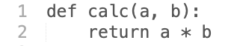

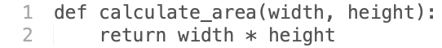
Code review checklist (1/13)
Variable names
Use descriptive names that convey intent
Slide adapted from materials: https://github.com/OxfordCodeReviewNet/forum/blob/master/guidelines_for_reviewers.md

Slide 36
Code review checklist (2/13)
Hard coded values
Avoid “magic numbers”

Slide 37
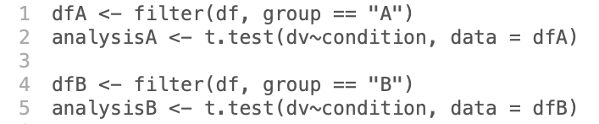
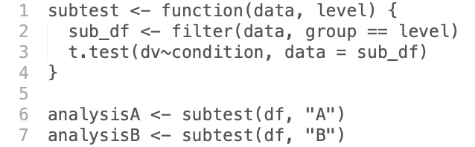
Code review checklist (3/13)
Duplicated code
Don’t repeat yourself (DRY)
Slide adapted from materials: CC-BY: DeBruine, Lisa (2022) Intro to Code Review. https://debruine.github.io/code-review/

Slide 38
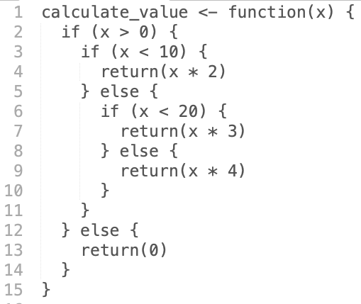
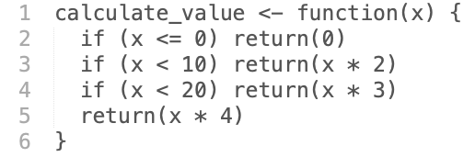
Code review checklist (4/13)
Complex if else statements
Flatten nested conditional statements with guard clauses
Slide adapted from materials: https://github.com/OxfordCodeReviewNet/forum/blob/master/guidelines_for_reviewers.md

Slide 39
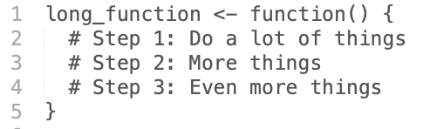
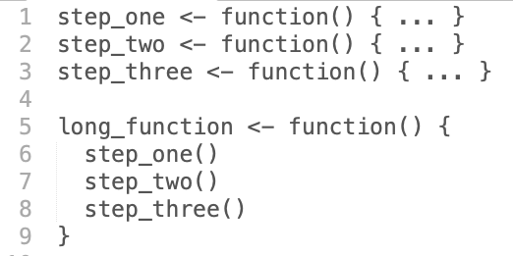
Code review checklist (5/13)
Long functions
Functions should be short and do one thing
Slide adapted from materials: https://github.com/OxfordCodeReviewNet/forum/blob/master/guidelines_for_reviewers.md

Slide 40
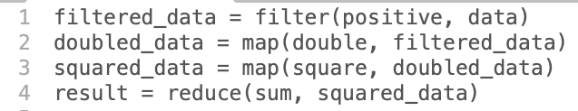
Code review checklist (6/13)
Obscure lines
Resist clever one-liners
Slide adapted from materials: https://github.com/OxfordCodeReviewNet/forum/blob/master/guidelines_for_reviewers.md

Slide 41
Code review checklist (7/13)
File paths
All file references should use relative paths, not absolute paths.
“here” R package: https://here.r-lib.org/
Slide adapted from materials: CC-BY: DeBruine, Lisa (2022) Intro to Code Review. https://debruine.github.io/code-review/

Slide 42
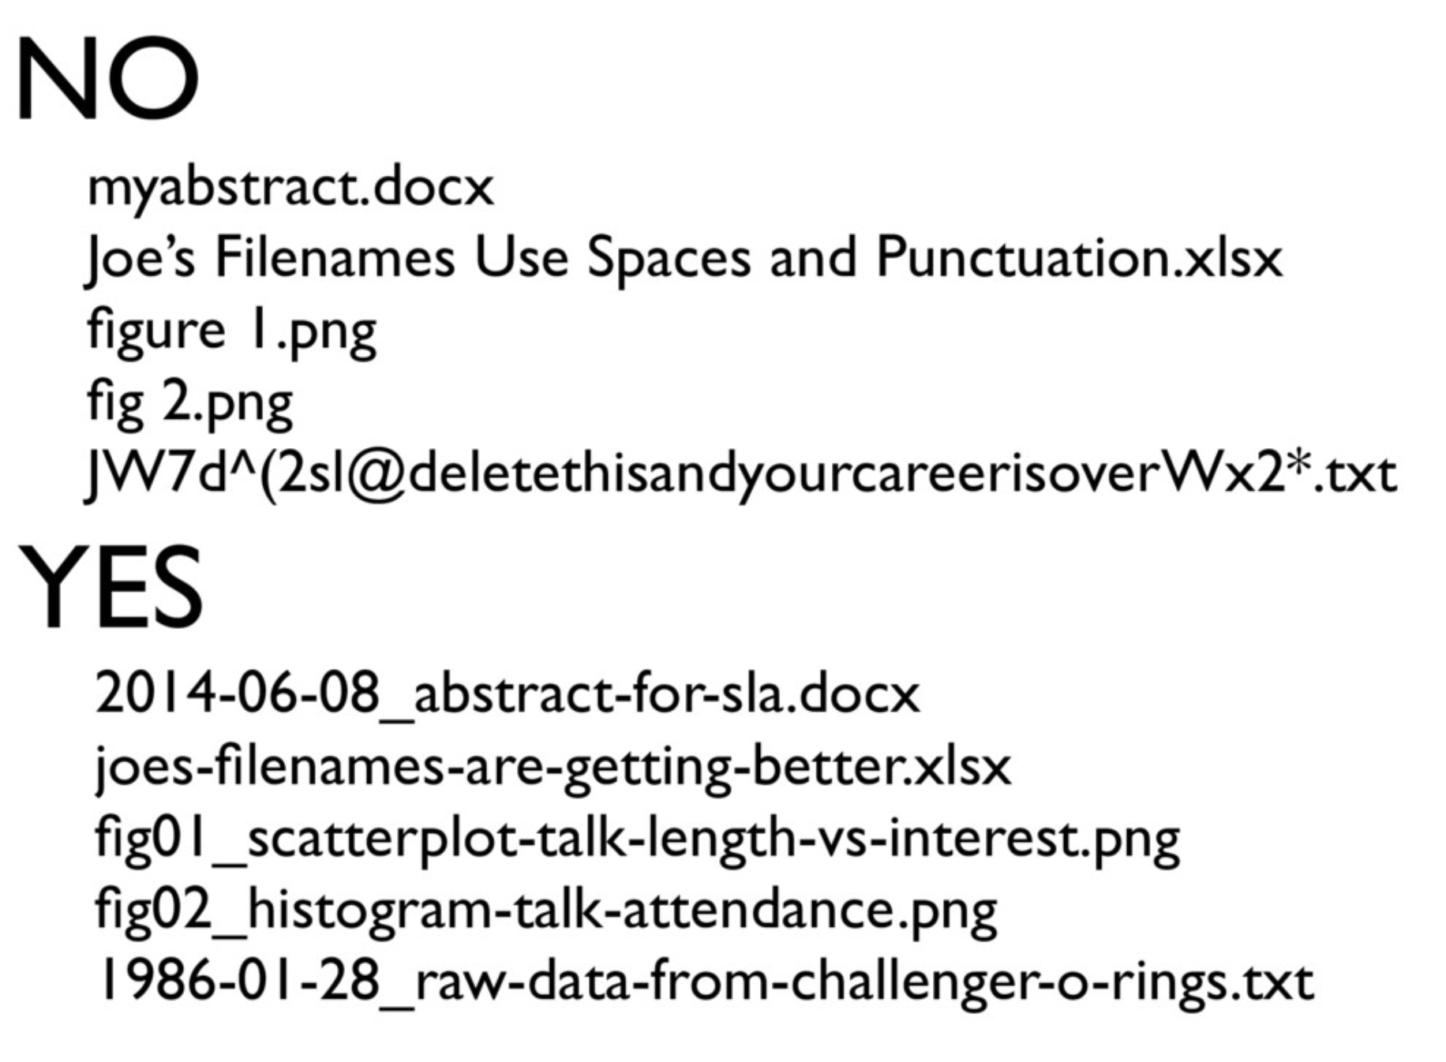
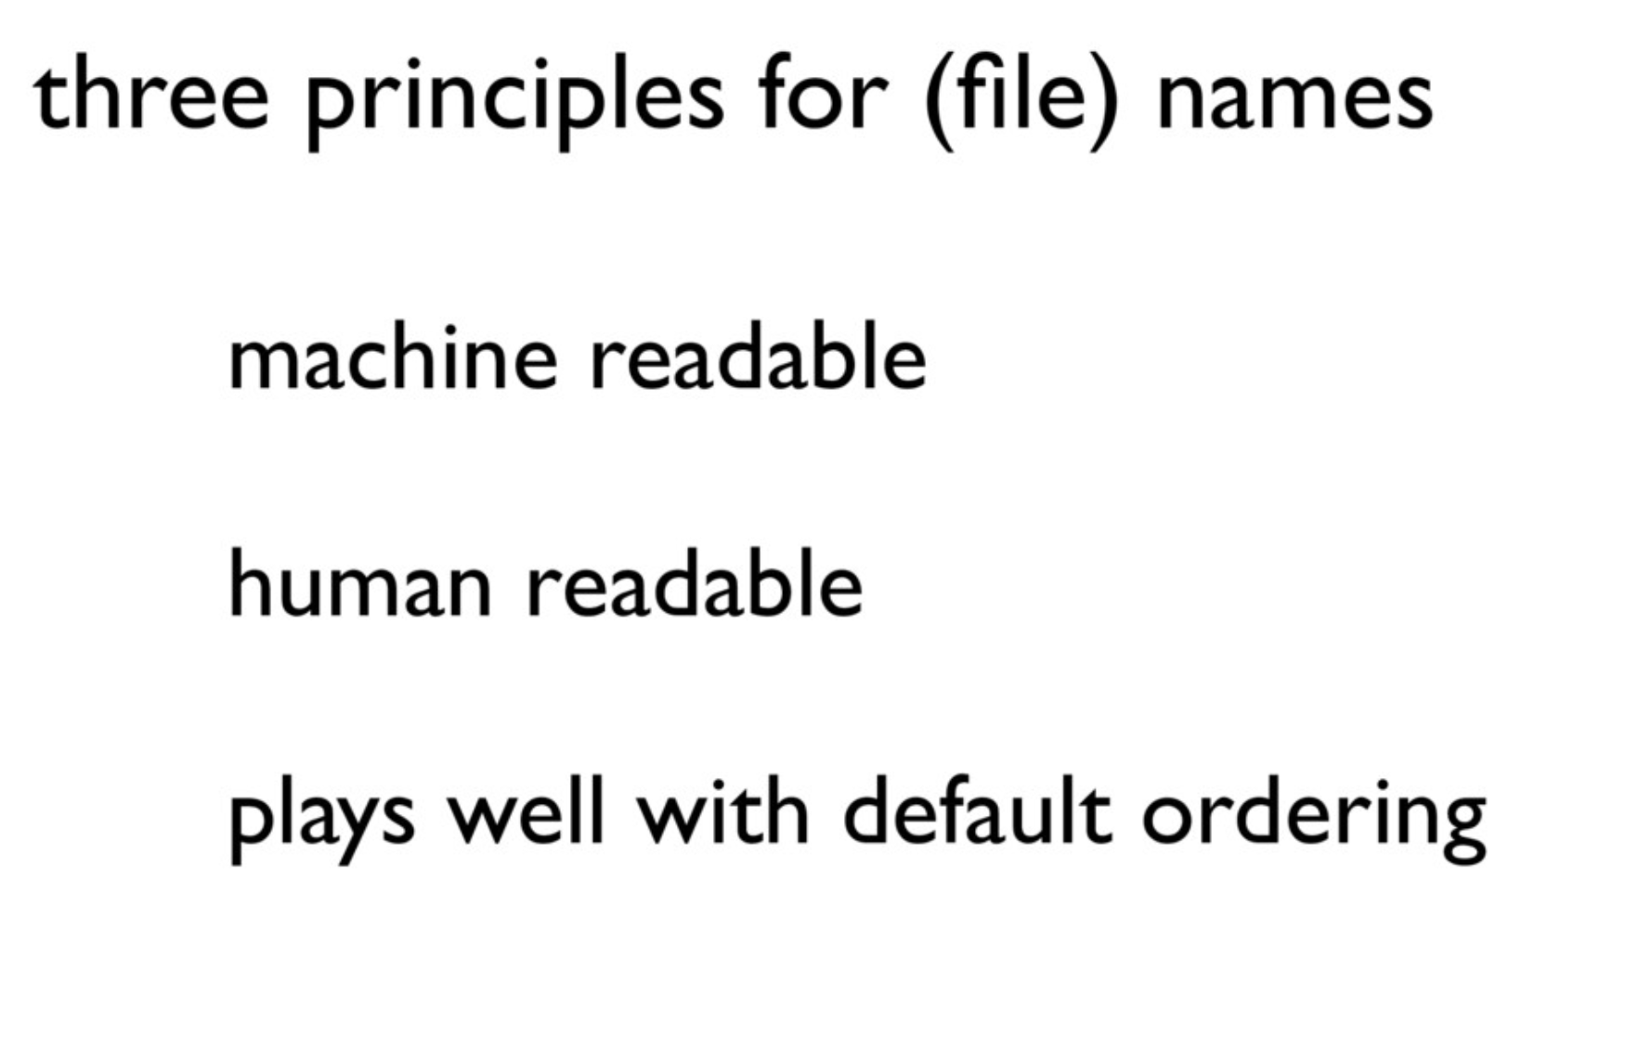
Code review checklist (8/13)
File names
Name files so both people and computers can easily find things
Use YYYY-MM-DD format for dates
Slide adapted from materials: CC-BY: DeBruine, Lisa (2022) Intro to Code Review. https://debruine.github.io/code-review/ https://speakerdeck.com/jennybc/how-to-name-files

Slide 43
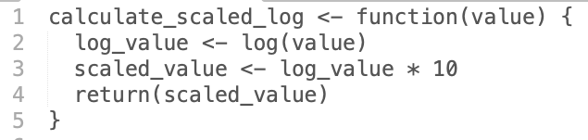
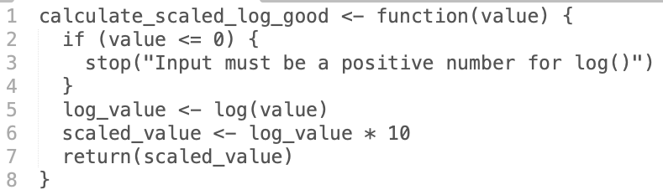
Code review checklist (9/13)
Unintended behaviour
Validate inputs to prevent unintended behaviour or errors
Slide adapted from materials: https://github.com/OxfordCodeReviewNet/forum/blob/master/guidelines_for_reviewers.md

Slide 44
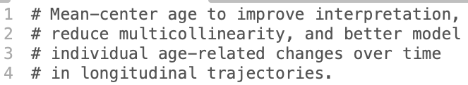
Code review checklist (10/13)
Comments
Explain the “why” not the “what”
Redundant comments
Complicated comments
Warnings of consequences
Assumptions made
Further info on writing good comments here: https://stackoverflow.blog/2021/12/23/best-practices-for-writing-code-comments/

Slide 45
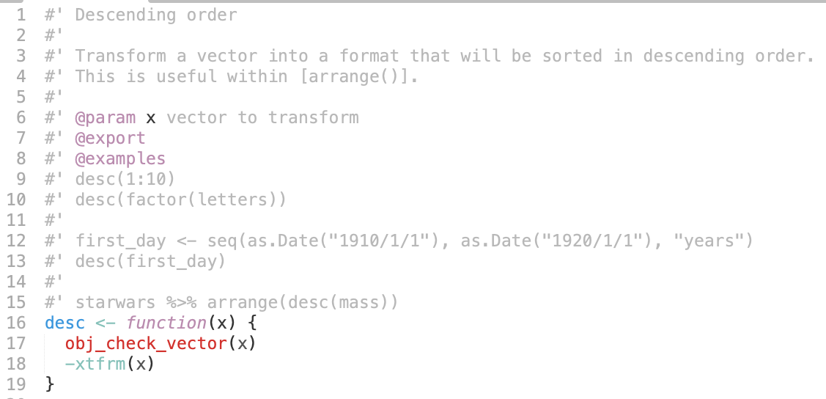
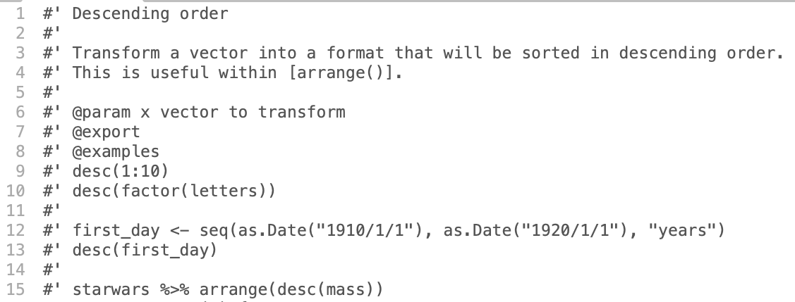
Code review checklist (11/13)
Documented code
Functions and classes should contain docstrings
Slide adapted from materials: https://github.com/OxfordCodeReviewNet/forum/blob/master/guidelines_for_reviewers.md

Slide 46
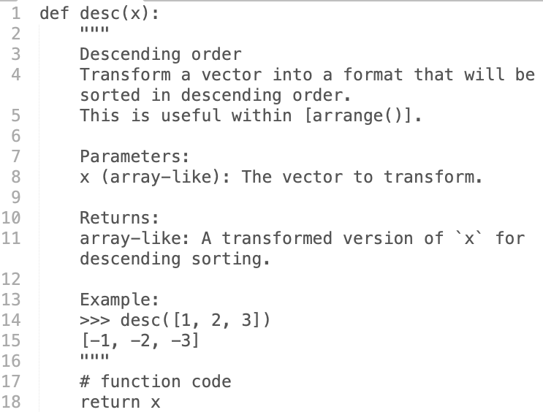
Code review checklist (11/13)
Documented code
Functions and classes should contain docstrings
Slide adapted from materials: https://github.com/OxfordCodeReviewNet/forum/blob/master/guidelines_for_reviewers.md

Slide 47
Code review checklist (12/13)
Documented data
Be clear, consistent, and provide context
Names (i.e., the column names)
Labels/description
Codings (e.g., 1 = always, 5 = never)
Data type (e.g., binary, continuous)
Descriptives (e.g., min, max)
Data units (e.g., mg/L, months)
Missing values (e.g., NA, 999)
Slide adapted from materials: CC-BY: DeBruine, Lisa (2022) Intro to Code Review. https://debruine.github.io/code-review/

Slide 48



Code review checklist (13/13)
Coding Style
“Good coding style is like correct punctuation: you can manage without it, butitsuremakesthingseasiertoread.”
Notation and naming
Syntax (spacing, indentations, line length)
Commenting guidelines
And more...
snake_case
kebab-case
Google style guide on many languages: https://google.github.io/styleguide/
R style guide: https://style.tidyverse.org/
Slide adapted from materials: https://github.com/OxfordCodeReviewNet/forum/blob/master/guidelines_for_reviewers.md

Slide 49

Code review checklist (13/13)
Automate what can be automated
Code author can use a linter to automate coding style checks before review
R – lintr R package
“lintr provides static code analysis for R. It checks for adherence to a given style, identifying syntax errors and possible semantic issues, then reports them to you so you can take action.”
Python - list of linters:
https://github.com/vintasoftware/python-linters-and-code-analysis

Slide 50

Code review checklist (13/13)
Using git hooks and pre-commits
Code author can use automated pre-commit checks before review
1
2
3
4
stage
changes
commit
changes
enter
commit
message
git push
= custom scripts triggered by git actions and events.
Pre-commit
Post-commit
Eg. linting, tests, large files...
https://git-scm.com/book/ms/v2/Customizing-Git-Git-Hooks
https://pre-commit.com/
Notes:
This is advanced.
Can skip if there’s no time.

Slide 51
Code review checklist (1-13)
Summary of checklist
Variable names
Hard coded values/magic numbers
Duplicated code
Complex if else statements
Long functions
Obscure lines
File paths
File names
Unintended behavior
Comments
Documented code
Documented data
Coding style (with automated checks using linter/git hooks)

Slide 52

Code review checklist (*)
Other things for a reviewer to check?

